Slide 1
ASSIGNMENT 1
SELECTING THE BEST PRODUCT FOR BANK
CONTENTS
INTRODUCTION
PRODUCT FACTS
GRAPH FOR TCO
TABLE FOR CAPEX AND OPEX
CONCLUSION

Slide 2
INTRODUCTION
The bank is provided with three different software products for the implementation of a new application Which are namely commercial product(product A) ,a cloud based SaaS product(product B) and a commercially supported open source software(product C). The aim is to select the product with low TCO(Total Cost Ownership) for implementation.
PRODUCT FACTS
Product A:
Its an commercial product that has six sub products namely A1,A2,A3,A4,A5 and A6. The license cost for the end users vary from A1 to A3 and the license cost for CPU vary from A4 to A6.The number of CPU’s to be used also varies from 2 to 8 based on the user’s count and also a maintenance cost of 18% of the license fee . It also has a disaster site with 30% maintenance fee . The implementation cost comes around £200000 along with 15 % maintenance fee.
Its takes 2 CPU for 300 users
4 CPU for 301 to 600 users
8 CPU for 601 to 1000 users
Product B:
Its an cloud based Saas product that uses hybrid license which costs £350 per end user and subscription fee of £300 for each end user and there is no disaster site and maintenance fee for the product.

Slide 3
Product C:
Its an commercially supported open source product with license fee of £25000 for each CPU installed.It has a implementation cost of £500000 and there is no annual maintenance fee .
It takes 2 CPU for 400 users
6 CPU for 401 to 600 users
8 CPU for 601 to 1000 users
Hardware :
Each CPU costs around £5000 with a maintenance fee of 10% of its cost.

Slide 4
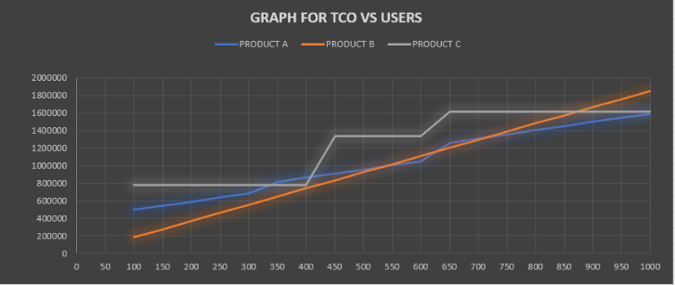
GRAPH FOR TCO(TOTAL COST OF OWNERSHIP)
Here the x-axis denotes the number of users
y-axis denotes the TCO
The graph shows that product A and product C starts with high total cost and ends with low total cost . And the product B starts with low cost and ends with highest total cost because of its operational costs

Slide 5
TABLE FOR CAPEX AND OPEX FOR THE PRODUCTS
Here the opex(operation expense) mentioned as “Opex from the second year “ states that the Opex is calculated with cpu’s maintenance cost.
The other factors that affect the TCO are
Staffing and labour costs
Security cost
Cost for bug fixing
Downtime cost
Data centre cost
PRODUCT NAME | CAPEX | OPEX FROM 2ND YEAR | TCO 5YRS ODJDJ | TCO 7YRS | TCO 10 YRS | TCO 15 YRS
PRODUCT A | 416200 | 67316 | 685464 | 820096 | 1022044 | 1358624
PRODUCT B | 195000 | 90000 | 555000 | 735000 | 1005000 | 1676200
PRODUCT C | 570000 | 52000 | 778000 | 882000 | 1038000 | 1144200

Slide 6
CONCLUSION
Based on the graph and table, the capex(capital expenditure) for the product c is higher in comparison with the capital expenditure(CAPEX) of product A and product B . But the Total cost of ownership is not only calculated based on Capital Expenditure , it also includes operational expenditure(OPEX) .The operational expenditure of the product B is high and it will affect the total cost of expenditure(TCO) over the years. Therefore the product C would be best option for the company because of its low operational expenditure cost(OPEX).

